Slide 1
Recap Session 3: Fourier Transforms
Sea Level Change – Spring 2021

Slide 2

Say we want to describe a curve…
The building blocks of all curves…
In mathematical terms
We do not know its characteristics or its complexity in advance

Slide 3
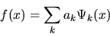
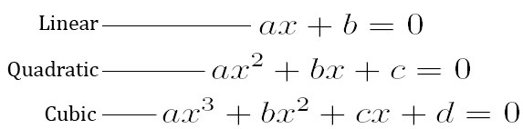
Basis functions
We can construct a function
f(t) = a₁Ψ₁(t) + a₂Ψ₂(t) + .... + a_{k}Ψ_{k}(t)
Every continuous function can be described by a combination of basis functions
Polynomial functions, e.g., consist of powers of t
f(t) = a₁Ψ₁(1) + a₂Ψ₂(t) +a₃Ψ₃(t²) + .... + a_{k}Ψ_{k}(t^{k})

Slide 4
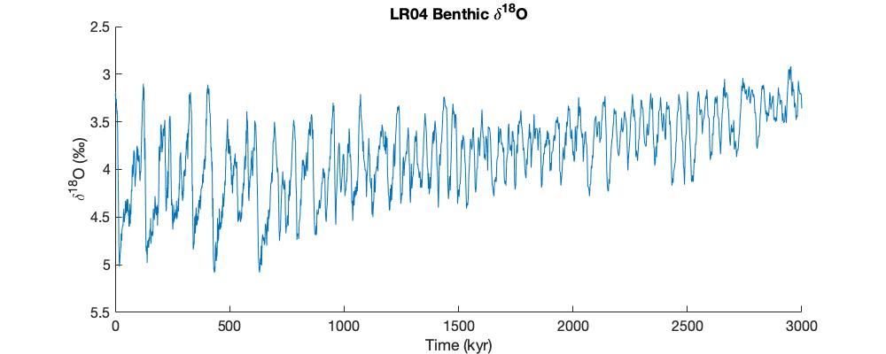
What if the data is periodic?

Slide 5
What if the data is periodic?
We can use Sine and Cosine functions

Slide 6
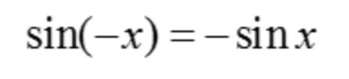
Reminders about sine & cosine
sin is an odd function
Symmetric about origin

Slide 7
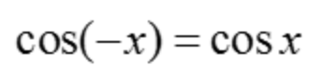
Reminders about sine & cosine
cos is an even function
Symmetric about y axis

Slide 8
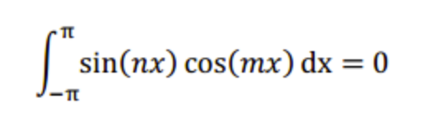
Reminders about sine & cosine
sin and cos are orthogonal
Dot (inner) product of sin & cos = 0
Notes:
Dot prod= multiply the length of a times the length of b, then multiply by the cosine of the angle between a and b

Slide 9
sinusoidal oscillation
f(t) = C cos{ 2π (t-t₀) / T }
amplitude, C
d(t)
period, T
time, t
delay, t₀
Notes:
Review the basic nomenclature

Slide 10
Some data can be fit with with only cos or sin

Slide 11
Some data can be fit with with only cos or sin
Why doesn’t the sin curve work for fitting this function?
Because sin(x) is an odd function, and this box plot is EVEN (symmetric about y axis!)

Slide 12
Some data can be fit with with only cos or sin
Cos curve fits much better!

Slide 13
Depends on the function

Slide 14
Depends on the function

Slide 15
How might we fit the curve with sine and cosine functions?

Slide 16
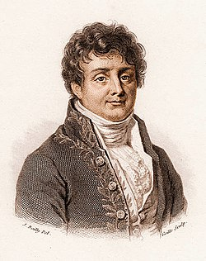
I bet that every periodic function can be described by an infinite sum of sine and cosine functions…
Fourier Series
Joseph Fourier

Slide 17
Terminology
Temporal
f(t) = C cos{ 2π t / T }
Spatial
f(x) = C cos{ 2π x / λ }
amplitude, C
amplitude, C
period, T
wavelength, λ
frequency, f=1/T
-
angular frequency, ω=2 π /T
wavenumber, k=2 π / λ
f(t) = C cos(ωt)
f(x) = C cos(kx)
Notes:
temporal periodicities are described differently than spatial periodicities.

Slide 18
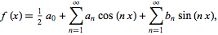
Fourier Series
OR
Recall:

Slide 19
Let’s take another look at the box curve
How well does this actually fit?

Slide 20
Let’s take another look at the box curve

Slide 21
Let’s take another look at the box curve
y = sin(t)
yr = y+ sin(3*t)/3

Slide 22
Let’s take another look at the box curve
y = sin(t)
yr = y+ sin(3*t)/3
Yy = y+ sin(3*t)/3 +sin(5*t)/5

Slide 23
Let’s take another look at the box curve

Slide 24
Let’s take another look at the box curve
Why not the even harmonics?
Notes:
When only some of the frequencies are used in the reconstruction, each edge shows overshoot and ringing (decaying oscillations). This overshoot and ringing is known as the Gibbs effect, after the mathematical physicist Josiah Gibbs, who explained the phenomenon in 1899.

Slide 25
Let’s take another look at the box curve
Notes:
Even harmonics don’t produce the result we are looking for

Slide 26
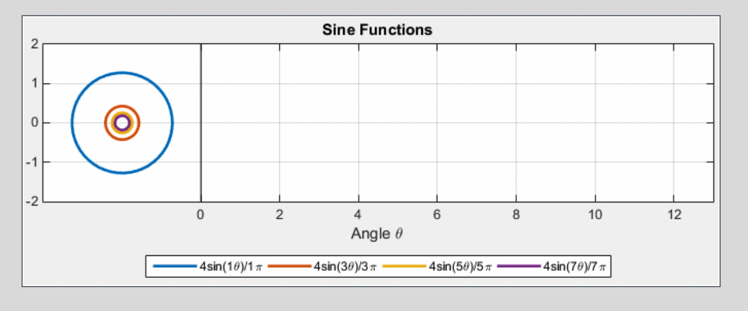
Why does this work?
Notes:
https://gist.github.com/amroamroamro/617305c05001caffc8d0#file-out1_-gif

Slide 27
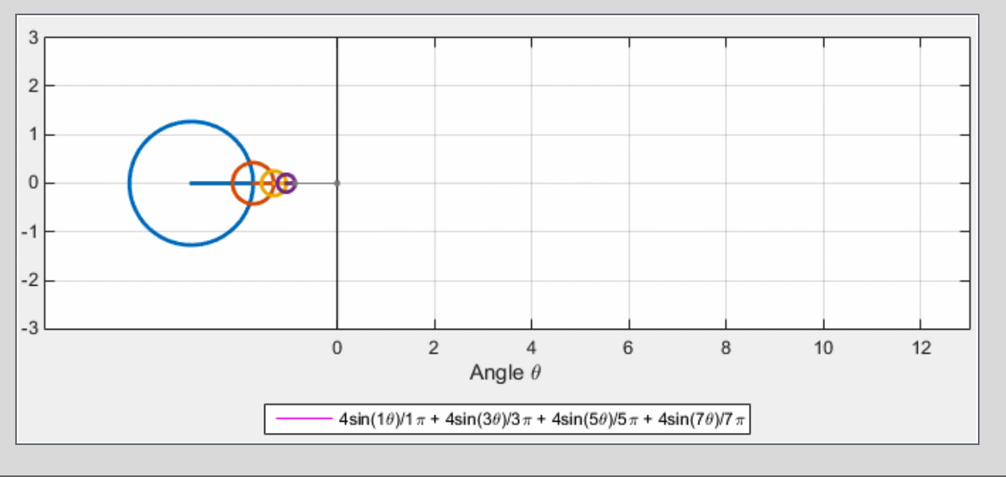
Why does this work?
Notes:
https://gist.github.com/amroamroamro/617305c05001caffc8d0#file-out1_-gif

Slide 28
What if we want to know the “building blocks” of our function?

Slide 29
Fourier Transform
Transformation from the time domain to the frequency domain:
Inverse Fourier Transform
Transformation from the frequency domain to the time domain:

Slide 30
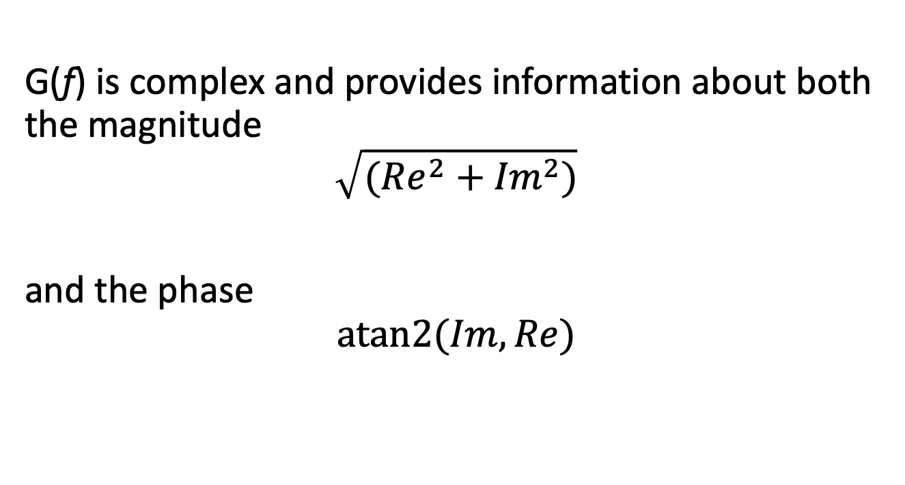
Fourier Transform
G(f) is complex and provides information about both the magnitude
$$\sqrt{({Re}^{2}+{Im}^{2})}$$
and the phase
$$atan2{(Im,Re)}$$
You can use the function fft in both Matlab and NumPy to preform the FT

Slide 31
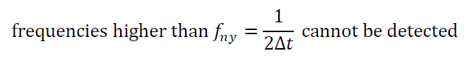
A word of caution …
Nyquist frequency
Notes:
This is very important.

Slide 32
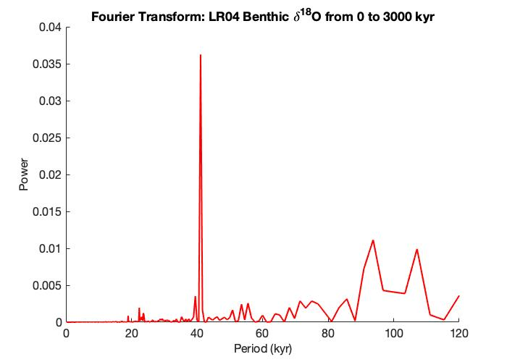

Slide 33
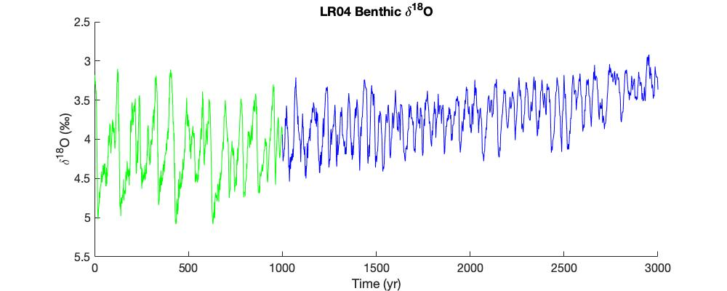
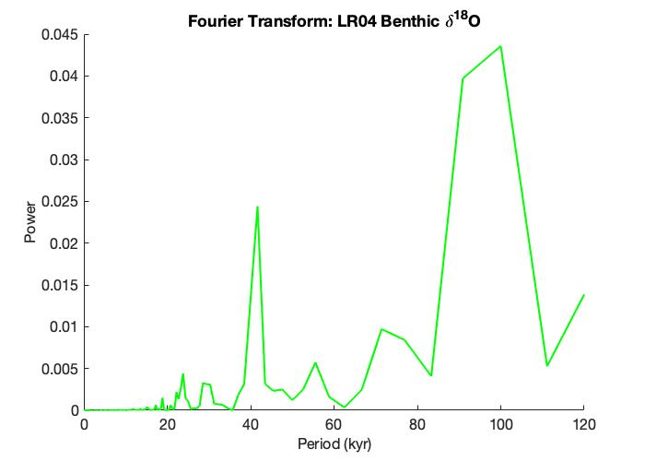
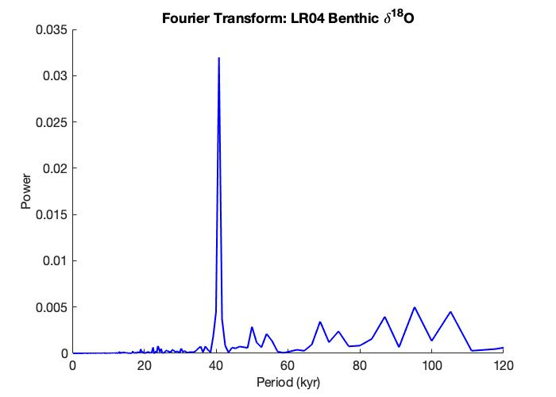

Slide 34
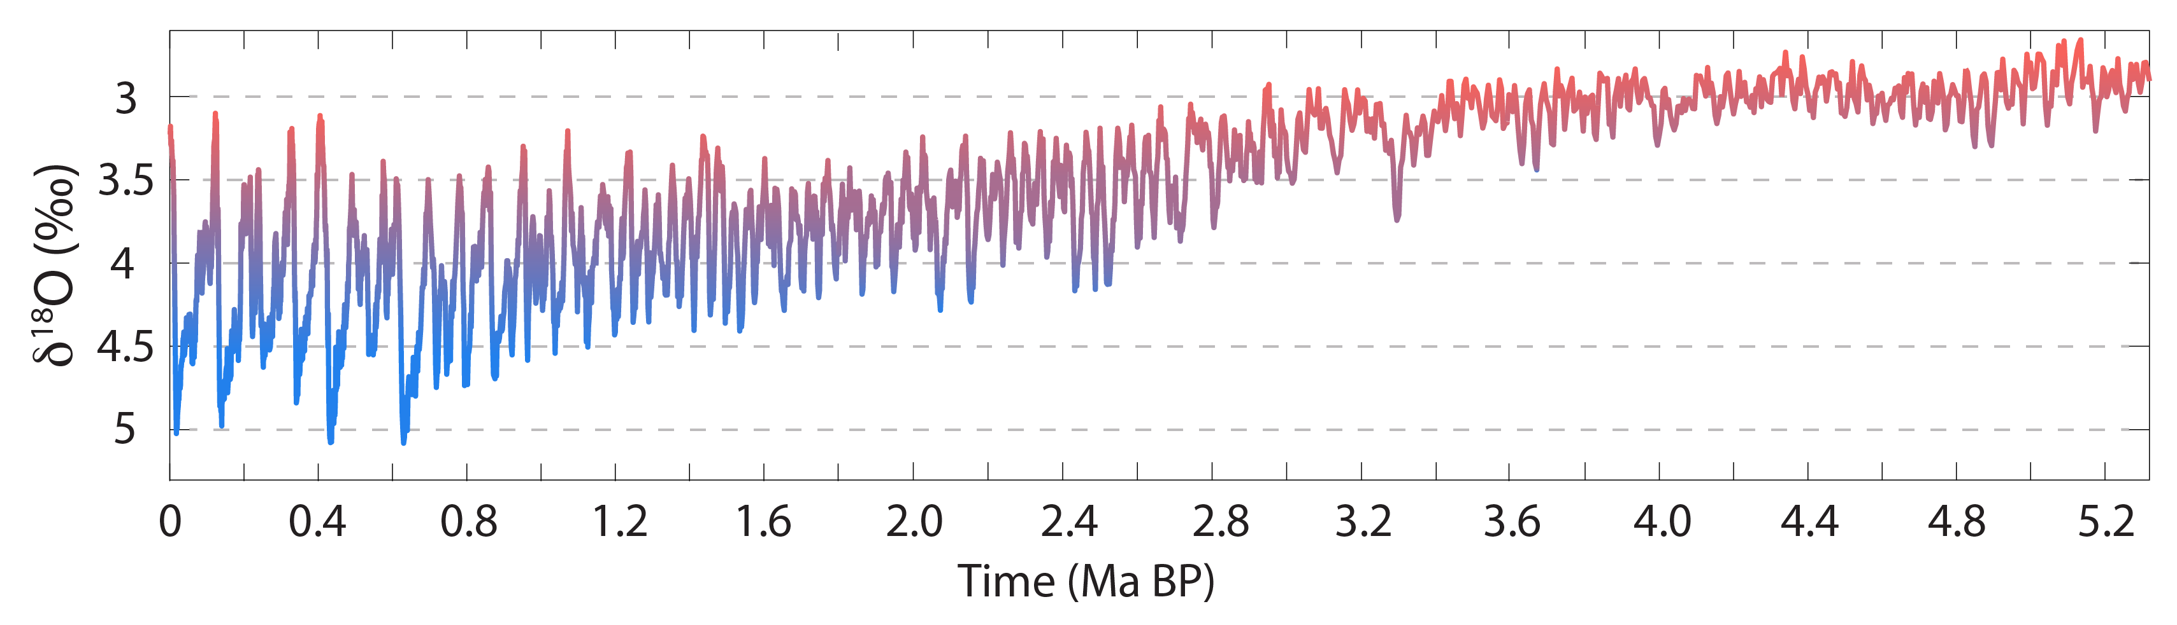
What drives ice sheet variability
Lisiecki and Raymo, 2005
Notes:
Temp -- constant, local effects averaged out

Slide 35
Milankovitch Theory
Variations in eccentricity, axial tilt, and precession of the Earth's orbit result in cyclical variations in the solar radiation reaching the Earth. This orbital forcing drives ice age cycles.

Slide 36
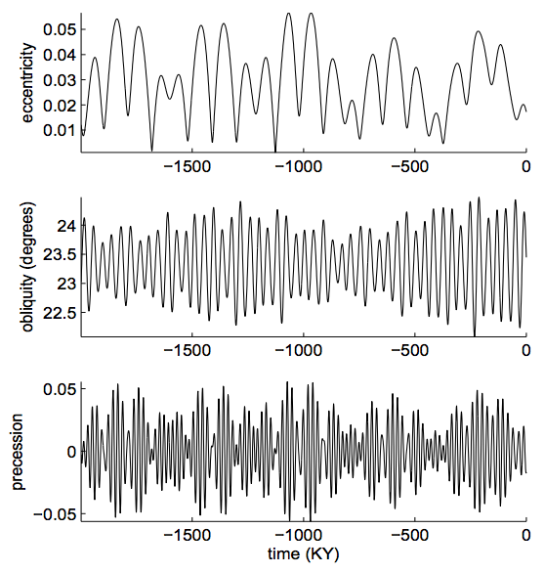
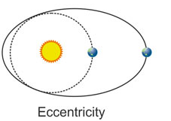
Eccentricity – 100 kyr
P. Huybers, PhD Thesis, 2004
Notes:
----- Meeting Notes (4/29/15 19:58) -----
change title - make it a sentence why we are looking at this
use insolation? if so define it?
Precession: varies how far or close you are during summer. Proportional to spatial and diurnal average of insolation during summer solstice
Precession index: eccentricity * sine of w

Slide 37
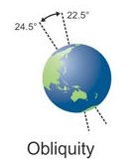
Obliquity – 40 kyr
P. Huybers, PhD Thesis, 2004
Notes:
----- Meeting Notes (4/29/15 19:58) -----
change title - make it a sentence why we are looking at this
use insolation? if so define it?
Precession: varies how far or close you are during summer. Proportional to spatial and diurnal average of insolation during summer solstice
Precession index: eccentricity * sine of w

Slide 38
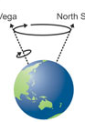
Precession – 20 kyr
P. Huybers, PhD Thesis, 2004
Notes:
----- Meeting Notes (4/29/15 19:58) -----
change title - make it a sentence why we are looking at this
use insolation? if so define it?
Precession: varies how far or close you are during summer. Proportional to spatial and diurnal average of insolation during summer solstice
Precession index: eccentricity * sine of w

Slide 39
What is the dominant mechanism?
Eccentricity
Obliquity
Precession
~ 100 kyr
~ 40 kyr
~ 20 kyr

Slide 40
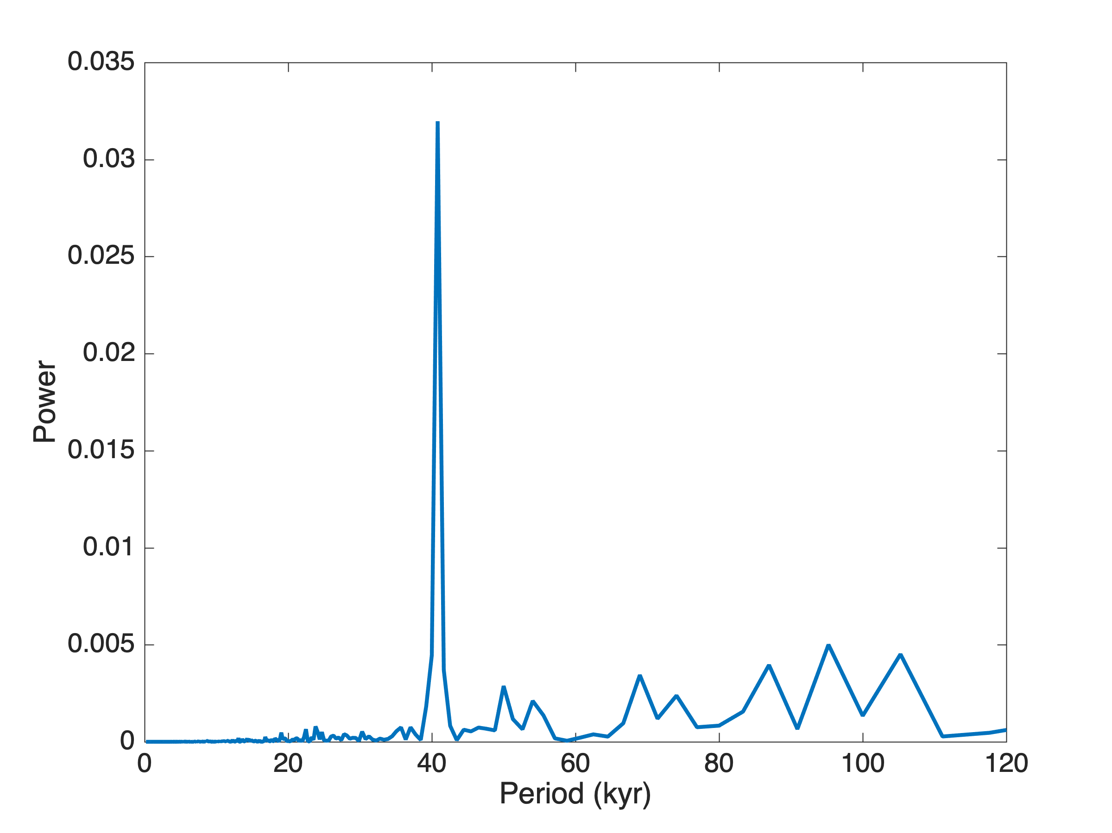
What are the dominant frequencies?
Fourier analysis
Lisiecki and Raymo, 2005
Notes:
Temp -- constant, local effects averaged out

Slide 41
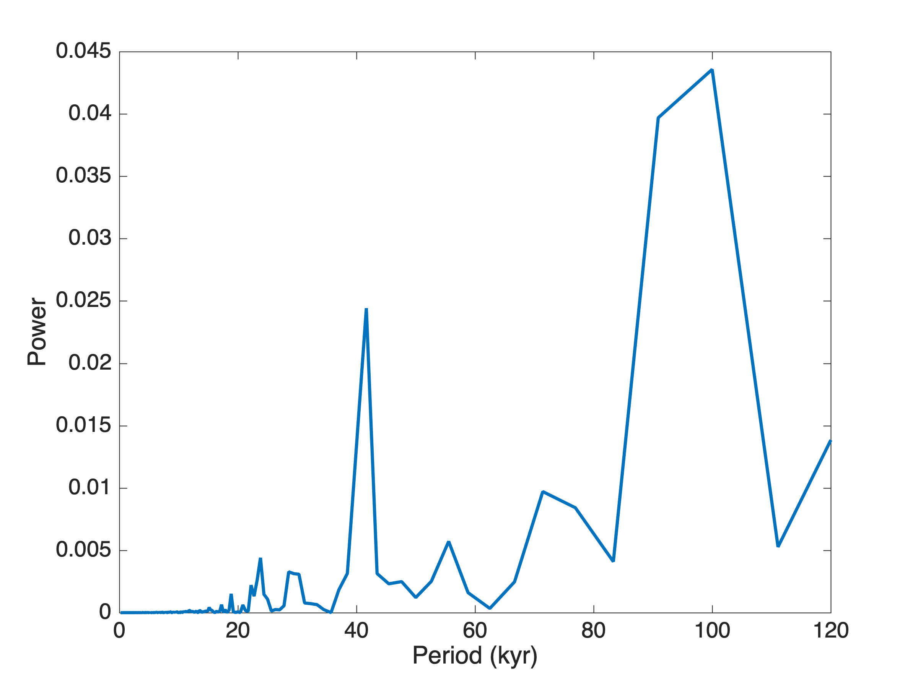
What process drives late Pleistocene glacial cycles?
Eccentricity – 100kyr
Obliquity – 40 kyr
Precession – 20 kyr
Lisiecki and Raymo, 2005
Notes:
Temp -- constant, local effects averaged out

Slide 42
What is the dominant mechanism?
40 kyr cycles are driven by obliquity.
100 kyr cycles are multiple (2x or 3x) 40 kyr cycles.
Feedbacks in the ice – climate system lead to sawtooth shape.
Does sea level actually follow a sawtooth shape?

